Slide 1

Foxes and Rabbits
Predator/Prey simulation
Introduction to Programming DS830
Merete H., Andreas L.N, Christoffer K.

Slide 2
Today’s Presentation:
Simulation Setup - Recursion -
Simulation and Simulation Entities
- Design choices / Alternative design choices -
Notes and changes in code

Slide 3
Simulation setup: Recursion
The simulation setup handles all menus and submenus that, when called, makes it possible for the user to change parameters for entities in the simulated world.
Key modules here are Foxes_and_rabbits, advanced_menu, config_menu, reporting_menu. These menus all include code for changing how the world and its entities should be setup.
To enter and exit menus, recursion has been implemented. Recursion is used for the sake of readability and to avoid less readable code when using fx a while-loop.
But we have not been consistent in the use of recursive calls. This challenges our intended thought of making more readable code.
Notes:
overvej “Fragile”

Slide 4
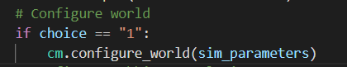

Example: Use of recursion 1/2
If user chooses config. “1”: We call the configuration_menu.
When user wants to go back: Recursive call to advanced_menu is made.
Notes:
Top level option (where the recursive call is placed in the sub menu), is, in our opinion, more readable.
However the lower option (where the recursive call is placed in the parent menu) avoids circular imports, which reduces dependencies and makes our code more modular, since the sub-menu does not have to import the parent menu.
However, we haven’t been consistent when chosing where to use the recursive call, and we have used both approaches.

Slide 5


Example: Use of Recursion 2/2
We could instead have chosen to call the advanced_menu when the configure_menu has been exited
When user chooses to exit configure_menu:
We “pass” and exit this code-segment and continue to make a recursive call back to the advanced_menu.

Slide 6
Simulation Entities
Design choices for the entities module:
Not using __eq__ since we did not consider specific attributes. We only needed information about the type and population of class instances.
Reproduction and Predators_in implemented in sub-classes.
Alternative design choices:
The method reproduce and Predators_in could be implemented by the superclass Animal
Making animals unique with an “ID”
Rules to behaviour:
An entity acts and behaves based on how we have programmed their autonomy and way of thinking.
A way to take this program and project further would be to reconsider the blueprint of an entity and give it even more specification. (Foxes or rabbits can see/Chance of escape/Chance of hide)

Slide 7
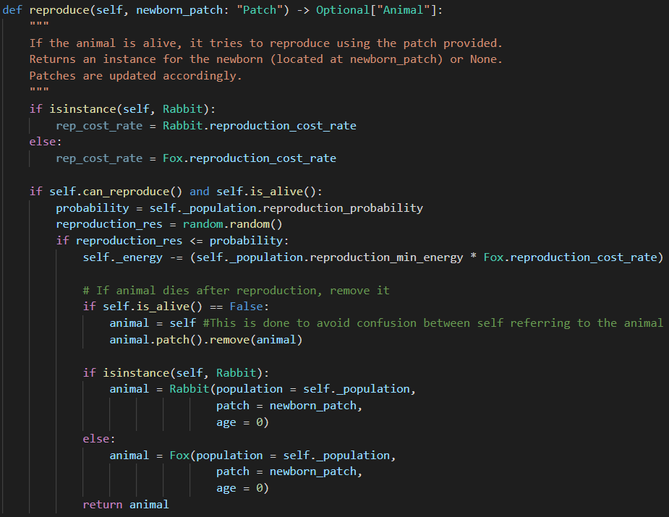
Alternative design choices: Reproduction
Reproduction could be implemented by the superclass animals.

Slide 8
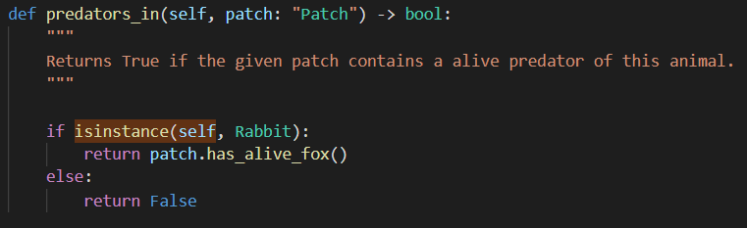
Alternative design choices: predators_in
To avoid redundancy, the method predators_in could, likewise, be implemented by the superclass Animal

Slide 9
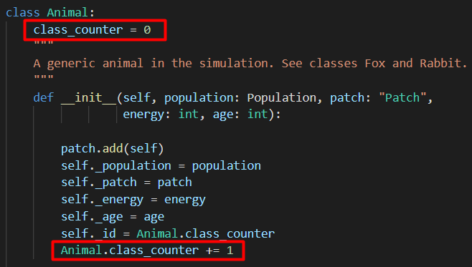

Alternative design choices __eq__
We could add an unique identifier to the animals to keep track of them individually.
We could add a __eq__ method, which would make it possible to compare animals and keep track of individual animals:

Slide 10


Notes and changes 1/6
Problem: When removing an animal we create a variable “animal” which is unnecessary.
Solution: Use the keyword “self”

Slide 11

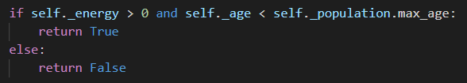
Notes and changes 2/6
Problem: Using boolean constants in guards
Solution: Use the keyword “not”
Problem: Returning boolean constants
Solution: Return the boolean expression

Slide 12
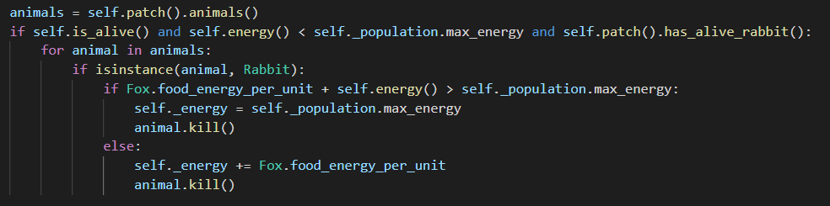
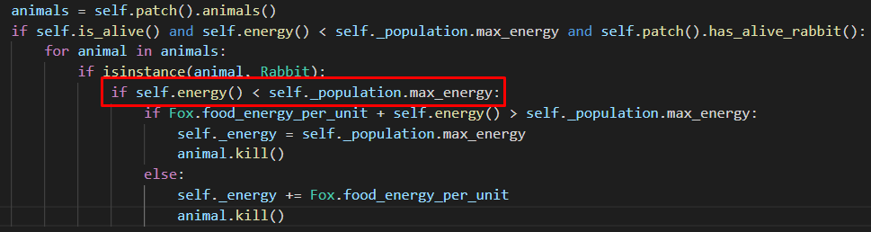
Notes and changes 3/6
Problem: Fox.feed assumes that a patch only contains one rabbit.
Solution: Add a guard to make sure, that the fox won’t eat anymore when full

Slide 13
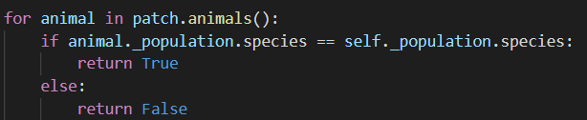
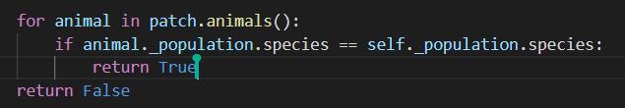
Notes and changes 4/6
The method same_species_in stops after first iteration
Solution: “Return” should be outside the if-statement and for-loop.

Slide 14
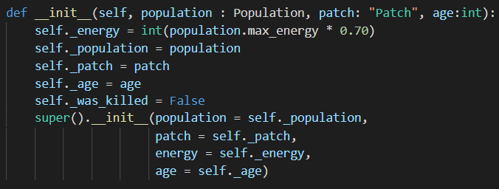
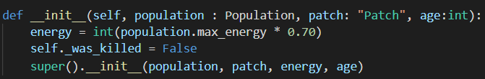
Notes and changes 5/6
Doing the same job twice. Unnecessary duplicate of operations.
Should’ve been taking advantage of the concept of inheritance in object oriented programming

Slide 15
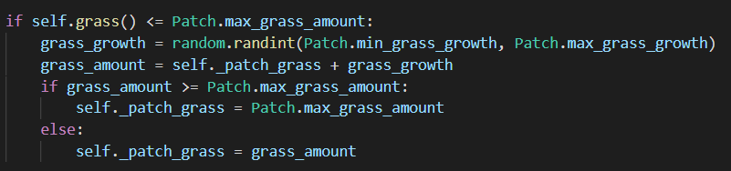
Notes and changes 6/6
Grass amount issue in patch.tick. Grass amount would exceed max grass amount.
Should have checked if max grass amount reached.
__repr__ should be __str__ instead. We don’t follow Python notation.

Slide 16
Thank you for your time!

Slide 17
Rules to behaviour
Once a world is created entities needs to be spawn into it.
Entities represents beings, things or objects from the reality that we are trying to simulate.
They can be coded to exist virtually. ex. Python Classes or object oriented programming.
When the blueprint is in its place and the entity is put into a world the point is for the entity to act and exist.
The cornerstone of a “successful” simulation.
An entity acts and behaves based on how it is programmed to behave.
The reason why rule-specified data and a lot of it can be a key for making 1:1 simulation models.
A way to take this program and project further would be to reconsider the blueprint of an entity and give it even more specification. (Foxes or rabbits can see/Chance of escape/Chance of hide)
Notes:
overvej “Fragile igen”

Slide 18
Modularity
def simulationsetup(Andreas): -> wisdom
def recursion(Merete): -> wisdom
Modularity:
Modules and functions should be as independent as possible
Small functions which uses auxiliary functions rather than big functions
Local rather than global scope
Easy to change different parts of the code
Notes:
rekursion, hvilke det spillede, hvordan det kunne forbedre (man skal sørge for at lukke funktioner), alternativt brug while-løkker, er det mere letlæseligt ikke at bruge while-løkker
Modularitet, scope,
Hvad blev implementeret?:
Foxes_and_rabbits modulet
Advanced_menu
Config_menus
Reporting_menu

Slide 19
Code collaboration (Merete)
Using git/github. Complications when not using the concept to its fullest.
Merge conflicts.
Git syntax.
Using IDLE and Visual studio code.
Started with IDLE and later moved to VS code
We wanted to be able to work simultaneously on our code so we chose to proceed with VS code due to its extension called ‘Live Share’.

Slide 20
Collecting simulation data to generate statistical insight
Hvad blev implementeret?:
Reporting module
Functions

Slide 21
Retrospect/Review
Recursion
Modular approach
Rules of behavior

